Slide 1

Design Patterns for Modern Backend Development
Modern backend development focuses on building robust, scalable, and efficient systems. It involves addressing challenges like high availability, data consistency, and performance optimization. Design patterns provide solutions to common issues in backend development.

Slide 2
An overview of Modern Backend Development
Server-Side Focus
Modern Backend Development
Cloud-Based Technologies
Back-end development involves everything that exists in the server. This includes everything from data modeling and storage to security concerns.
Modern backend development is all about creating software systems that power the server-side of web applications and services. To accomplish this, backend developers must create systems that are scalable, dependable, and efficient.
This typically involves the adoption of cloud-based technologies and a microservices architecture, allowing developers to construct systems capable of supporting high traffic volumes and offering flexibility and ease of management.

Slide 3

What’s Design Patterns
1
Reusable Solutions
Design patterns are reusable solutions to common problems that occur during software design.
2
Best Practices
These patterns provide best practices for solving issues related to object creation, structure, and behavior in a way that is adaptable, efficient, and maintainable.

Slide 4

Importance of Design Patterns
Simplified Coding
Enhanced Maintainability
Design patterns can simplify the coding process.
Design patterns enhance code maintainability.
Promote Code Reuse
Efficient, Scalable, Adaptable Code
Design patterns promote code reuse.
Design patterns help developers write code that is more efficient, scalable, and adaptable.

Slide 5
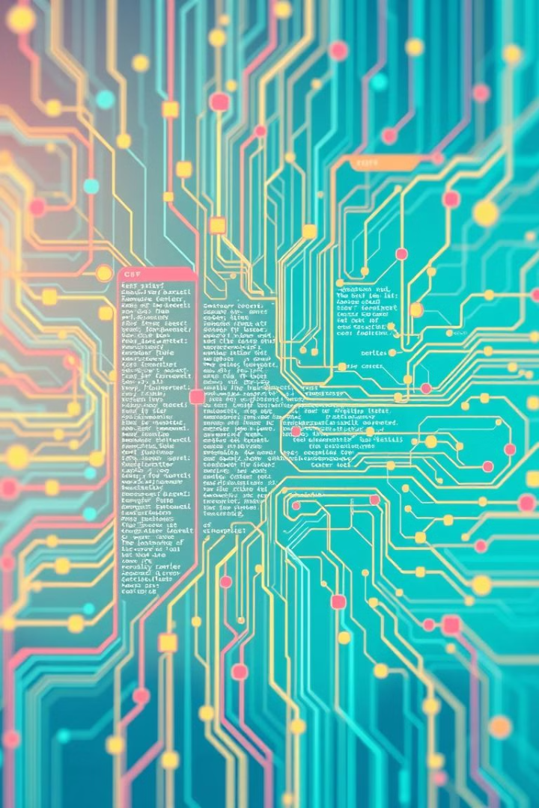
Advantages of Using Design Patterns
Code Reusability
One of the main advantages of using design patterns is code reusability.
Scalability
Design patterns allow for scalability in applications, as they provide a structured approach to writing code.
Simplified Testing and Debugging
Design patterns help create modular and testable code by breaking down functionality into well-defined units.
Maintainability
Using design patterns can make code more maintainable, as they provide a standardized approach to solving problems.
Reduced Errors
Design patterns are tried and tested solutions to common problems. By using these patterns, developers can avoid common errors and pitfalls.

Slide 6
Common Design Patterns
1
MVC (Model-View-Controller) Pattern
2
Repository Pattern
3
Dependency Injection Pattern
Separates an application into three interconnected components: Model, View, and Controller.
Encapsulation of data access logic enables the application to interact with a repository, rather than directly with the database or external data sources.
Promotes loose coupling by injecting dependencies (like services or objects) into a class rather than letting the class instantiate them itself.
4
Observer Pattern
5
Decorator Pattern
Establishes a one-to-many dependency between objects. When the state of the subject changes, all dependent observers are notified and updated automatically.
Allows behavior to be added to individual objects dynamically without affecting the behavior of other objects from the same class.

Slide 7
MVC (Model-View-Controller) Pattern
Purpose
Advantages
Disadvantages
Separates an application into three interconnected components: Model, View, and Controller.
Separation of Concerns, Modularity, Flexibility, Code Reusability.
Complexity, Learning Curve, Increased File Count.

Slide 8
MVC (Model-View-Controller) Pattern: Django Example
Django is a Python web framework that follows the MVC architecture pattern.
The Django framework separates an application into three parts:
Model: Represents data models. Django's ORM allows developers to define data structures with fields, relationships, and validation rules.
View: Defines the user interface of the application. View components typically use HTML templates to render the information displayed to the user.
Controller: Handles the logic between the model and the view. In Django, view functions in the views.py file act as controllers, taking input from the user, processing data from the model, and then passing it to the view for rendering.

Slide 9
Repository Pattern
Purpose
Advantages
Disadvantages
The Repository Pattern encapsulates data access logic, allowing the application to interact with a repository instead of directly with the database or external data sources.
The Repository Pattern offers benefits like centralized data access, enhanced testability, improved code maintainability, and reusability and extensibility.
The Repository Pattern can introduce overhead for simple applications and may require additional development time and learning curve.

Slide 10
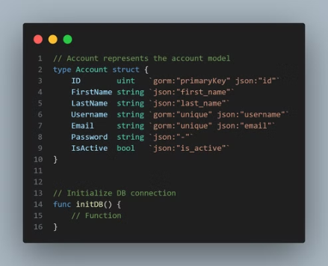
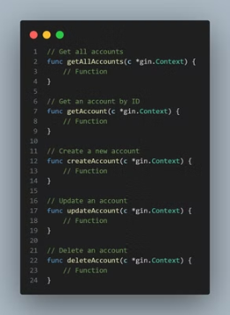
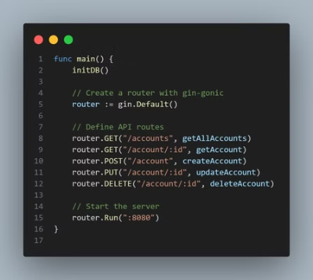
Repository Pattern: Go Example

Slide 11
Dependency Injection Pattern
Purpose
Advantages
Disadvantages
Dependency Injection promotes loose coupling by injecting dependencies, such as services or objects, into a class. This prevents the class from being responsible for its own instantiation.
Dependency Injection offers numerous benefits, including increased modularity, improved testability, reduced coupling, and easier collaboration and reusability. These advantages contribute to a more maintainable and flexible codebase.
Dependency Injection also comes with some challenges. It can lead to increased complexity, runtime errors, and testing complexities. Debugging can be more challenging and transparency may be impacted.

Slide 12
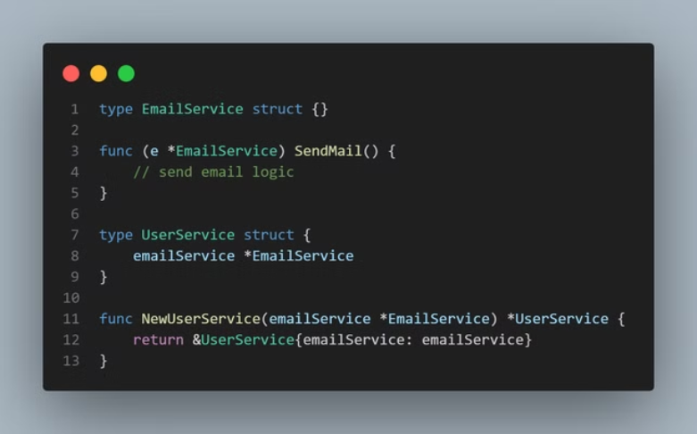
Dependency Injection Pattern: Go Example

Slide 13
Observer Pattern
Purpose
Advantages
Disadvantages
Establishes a one-to-many dependency between objects. When the state of the subject changes, all dependent observers are notified and updated automatically.
Offers loose coupling, scalability, automated updates, event-driven design, and improved maintainability. This pattern promotes flexibility and responsiveness.
Can introduce potential memory leaks, complex debugging scenarios, indirect dependencies, and overhead. It's crucial to manage these downsides carefully.

Slide 14
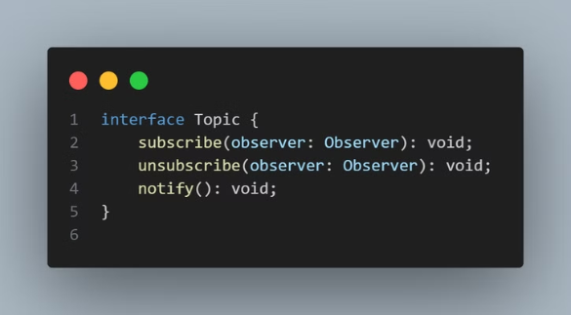
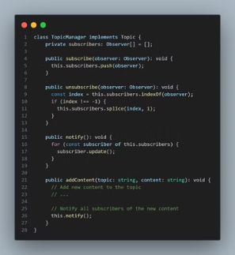
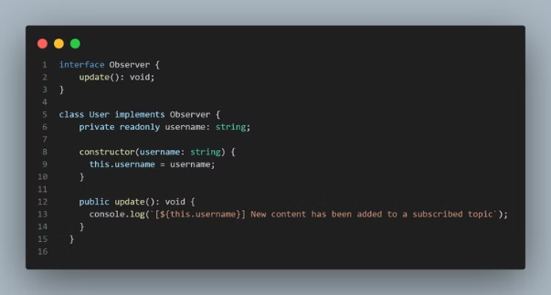
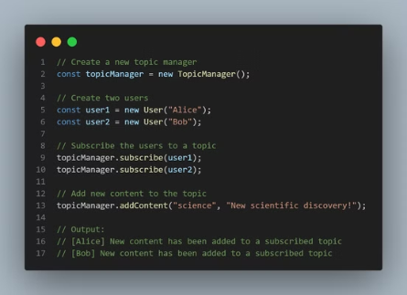
Observer Pattern: TypeScript Example

Slide 15
Decorator Pattern
Purpose
Advantages
Disadvantages
The Decorator Pattern enhances existing objects dynamically, adding new functionalities without modifying their core structure. It achieves this through the use of "decorator" objects that wrap around the original object, extending its behavior.
It adheres to the Open-Closed Principle, promoting code reusability and favoring composition over inheritance. It provides a flexible approach for extending functionality without altering existing code.
While powerful, the Decorator Pattern can increase complexity, especially when dealing with a chain of decorators. Careful consideration is required to manage the order of decoration to avoid unexpected behavior.

Slide 16
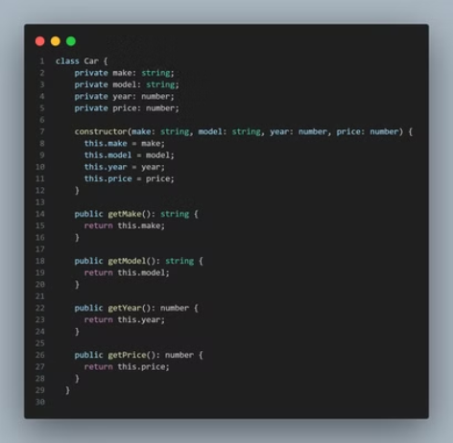

Decorator Pattern: Typescript Example

Slide 17

Conclusion
In conclusion, Design patterns are vital in modern backend development, offering reusable solutions to common design problems. Patterns like MVC, Repository, and Dependency Injection help build scalable, efficient, and maintainable systems. They ensure code reusability, simplify testing, and support high-traffic applications.

